Slide 1

Aureate
Name : Aftab Sipahi [ 19012012005 ]
Internal guide : Chirag Gami
1

Slide 2
TABLE OF CONTENT
DESCRIPTION
TECHNOLOGY
SYSTEM DESIGN
CONCLUSION
1
2
3
4
5
6
7
8
SCOPE
SYSTEM FUNCTION & FEATURES
SNAP SHOTS
FUTURE SCOPE

Slide 3
1.
DESCRIPTION
Let’s start with the first set of slides
3

Slide 4
Description
The "Aureate" has been developed to override the problems prevailing in the practising manual system. This software is supported to eliminate and, in some cases, reduce the hardships faced by this existing system.
Moreover, this system is designed for the particular need of the company to carry out operations in a smooth and effective manner. The application is reduced as much as possible to avoid errors while entering the data. It also provides an error message while entering invalid data. No formal knowledge is needed for the user to use this system. Thus, by this all it proves it is user-friendly.

Slide 5
2.
SCOPE
Here is the scope of project
5

Slide 6
Scope
Scope of the project Aureate, It may help collecting perfect management
in detail. In a very short time, the collection will be obvious, simple and
sensible. It will help a person to know the management of the past year
perfectly and vividly. It also helps in current work relative to the Online
Food Ordering System. It will also reduce the cost of collecting the
management & collection procedure will go on smoothly. Our project
aims at Business process automation, i.e. we have tried to computerise
various processes of Online Food Ordering System.

Slide 7
3.
Technology
Technology use to create project
7

Slide 8
Technology
HTML / CSS
JavaScript

Slide 9
4.
System Function & Features
Function & Features of project
9

Slide 10
Function & Features
Accuracy in work.
Easy & fast retrieval of information.
Well-designed reports.
Decrease the load of the person involved in existing manual system.
Access of any information individually.
Work becomes very speedy.
Easy to update information
Fast deliver

Slide 11
5.
System Design
Diagrams
11

Slide 12
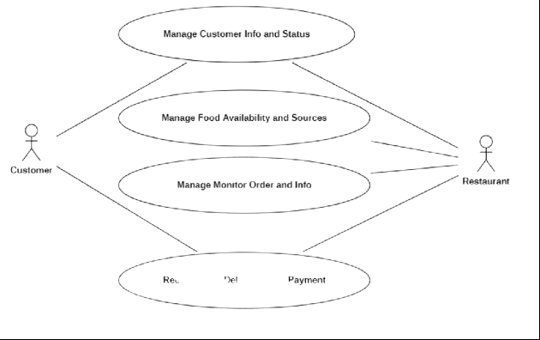
Use Case Diagram

Slide 13
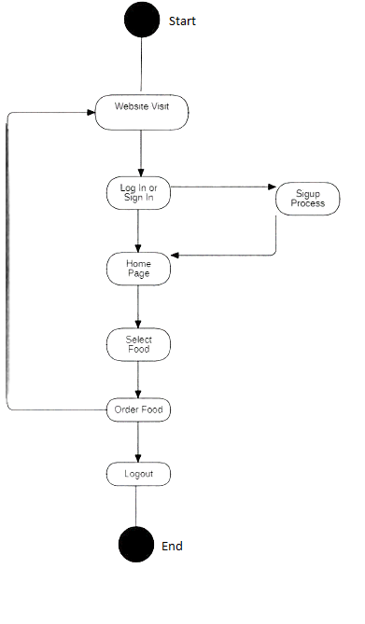
2. Sequence Diagram

Slide 14
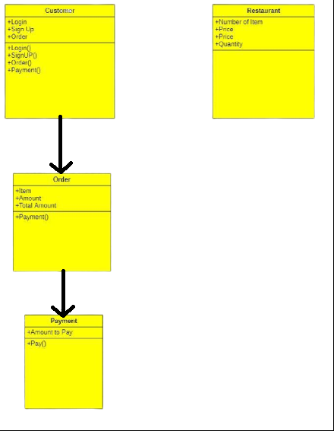
3. Class Diagram

Slide 15
6.
Snap Shot
Outputs
‹#›

Slide 16
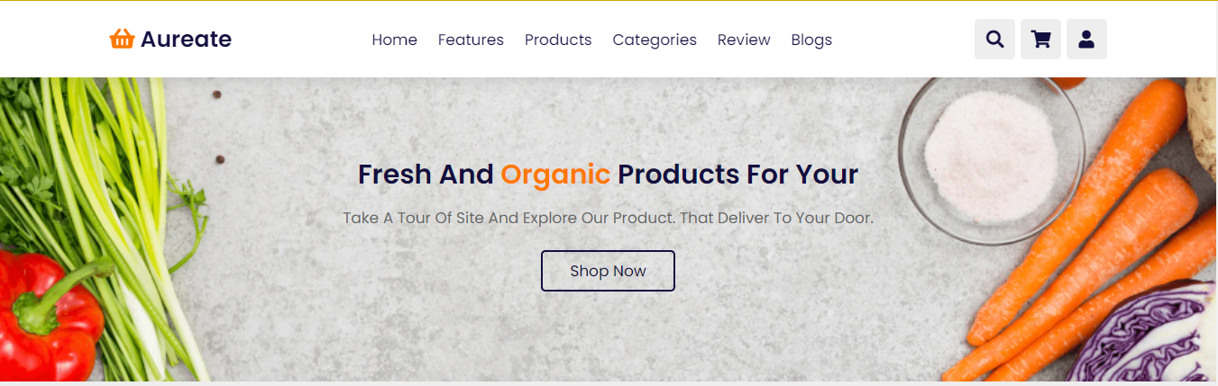
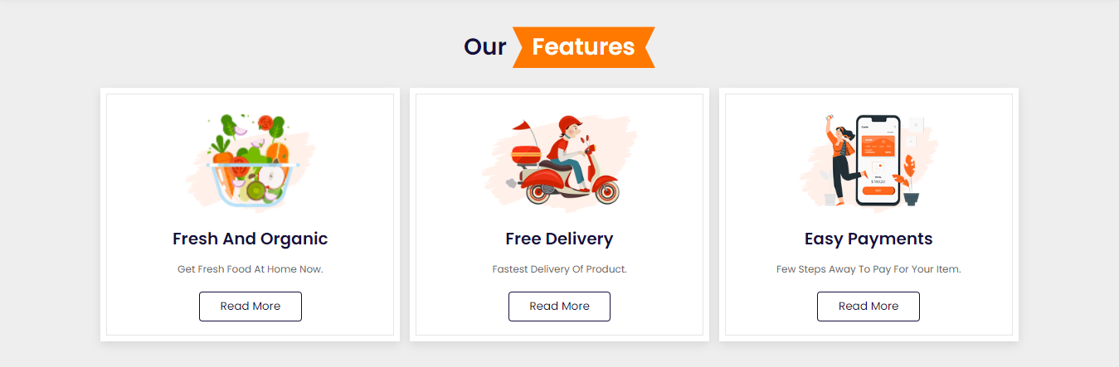
‹#›

Slide 17
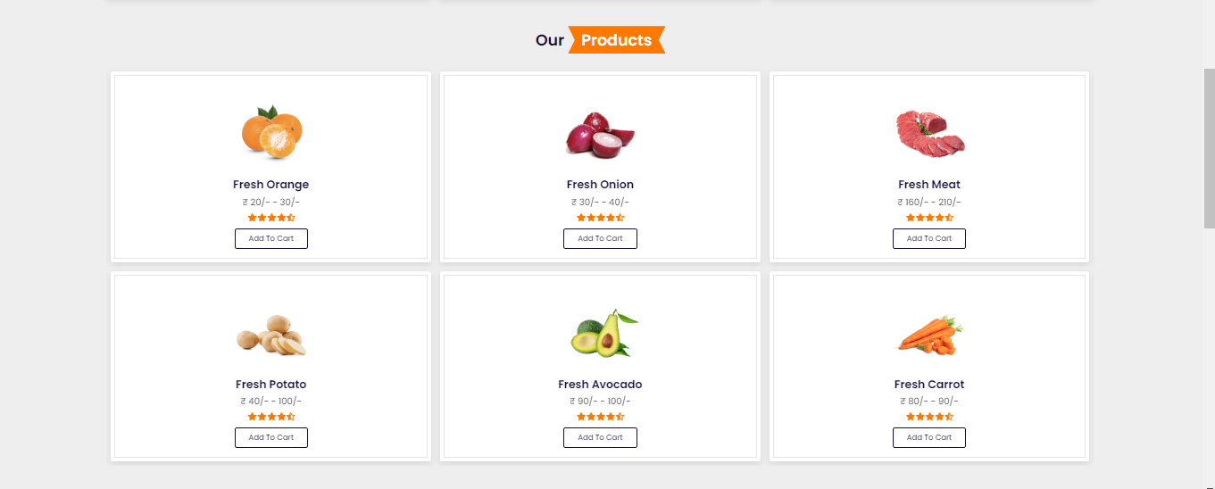
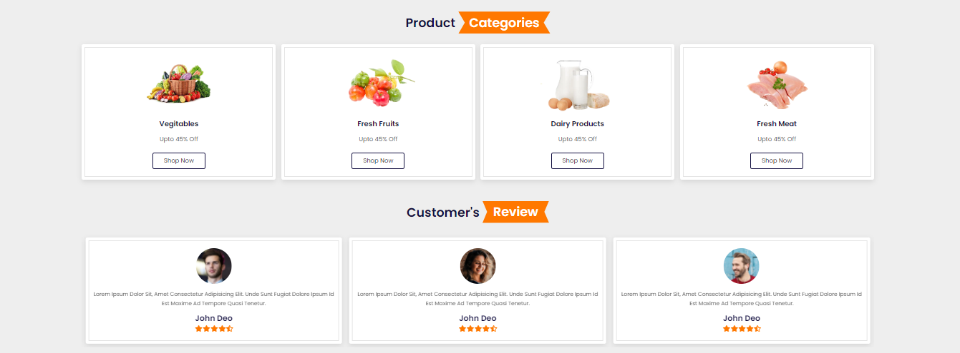
‹#›

Slide 18
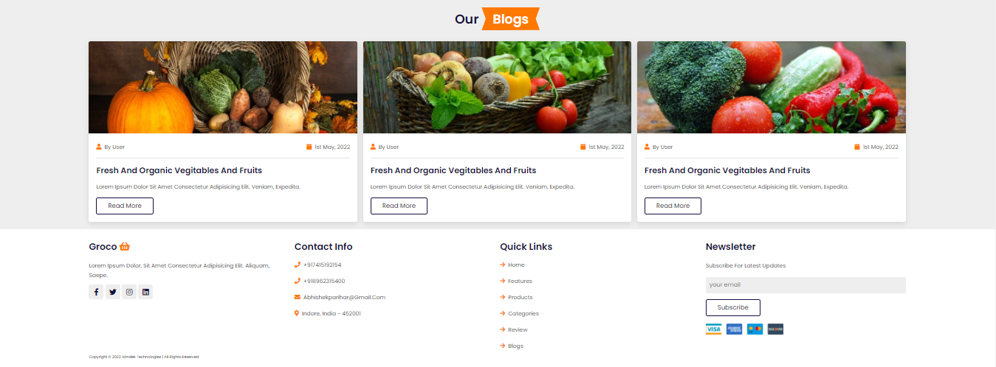
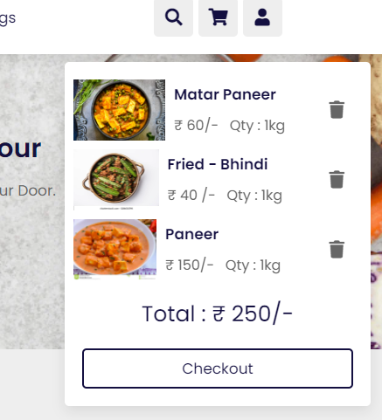
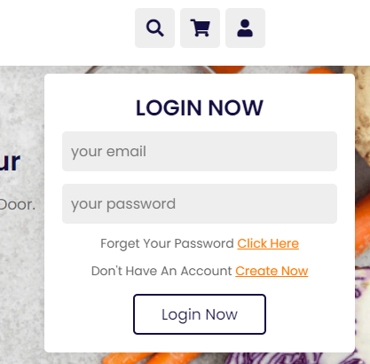
‹#›

Slide 19
7.
Conclusion
End of Project
‹#›

Slide 20
Conclusion
Our project is only a humble venture to satisfy the needs to manage their project work. Several user friendly coding have also adopted. This package shall prove to be a powerful package in satisfying all the requirements of the school. The objective of software planning is to provide a framework that enables the manger to make reasonable estimates made within a limited time frame at the beginning of the software project and should be updated regularly as the project progresses.

Slide 21
8.
Future Work
Enhance
‹#›

Slide 22
Future Work
We can add printers in future.
We can give more advance software for Online Food Ordering System including more facilities
We will host the platform on online servers to make it accessible worldwide
Integrate multiple load balancers to distribute the loads of the system
Create the master and slave database structure to reduce the overload of the database queries
Implement the backup mechanism for taking backup of codebase and database on regular basis on different servers

Slide 23
THANKS!
End of Presentation……..

